Slide 1
Electric Vehicle Projected Sales
Group 6:
Arnold Tchuente
Hossein Dabiri
Veronica Cheng

Slide 2
OUTLINE
Introduction
Objective
Source of Data and Database
Languages and Tools
Data Exploration
Visualization
Machine Learning Models
Results and Conclusions
Recommendations for Future Analysis

Slide 3

PROJECT OVERVIEW

Slide 4

Introduction
Electric vehicles (EVs) are the key technology to decarbonise road transport, a sector that accounts for 16% of global emissions.
EVs are gaining popularity and market share. In Q2 2022, EV sales accounted for 5.6% of the total auto market (up from 2.7% in Q2 of 2021). The U.S. Federal Government has set a goal to make half of all new vehicles sold in the U.S. in 2030 zero-emissions vehicles.
However, EV sales in some area have been slow due to higher purchase costs and a lack of charging infrastructure availability.
We want to figure out how the EV market in New York State (NYS) in the U.S. is projected to grow through the analysis of historical data for EV registrations.
Notes:
Electric vehicles (EVs) are vehicles that are either partially or fully powered on electric power. It outperforms conventional vehicles providing higher fuel economy, low carbon emission & maintenance, smoother drive, and reduced sound from engine

Slide 5
Objective
After exploring the EV registrations and the number of charging stations in NYS from 2012 to 2021, machine learning models were built to predict:
The number of EVs and the demand for EV charging stations in NYS in 2023
The total EV Adoption from 2020 to 2050 in NYS
The Electrical Infrastructure Sustainability for EVs in NYS by 2050

Slide 6
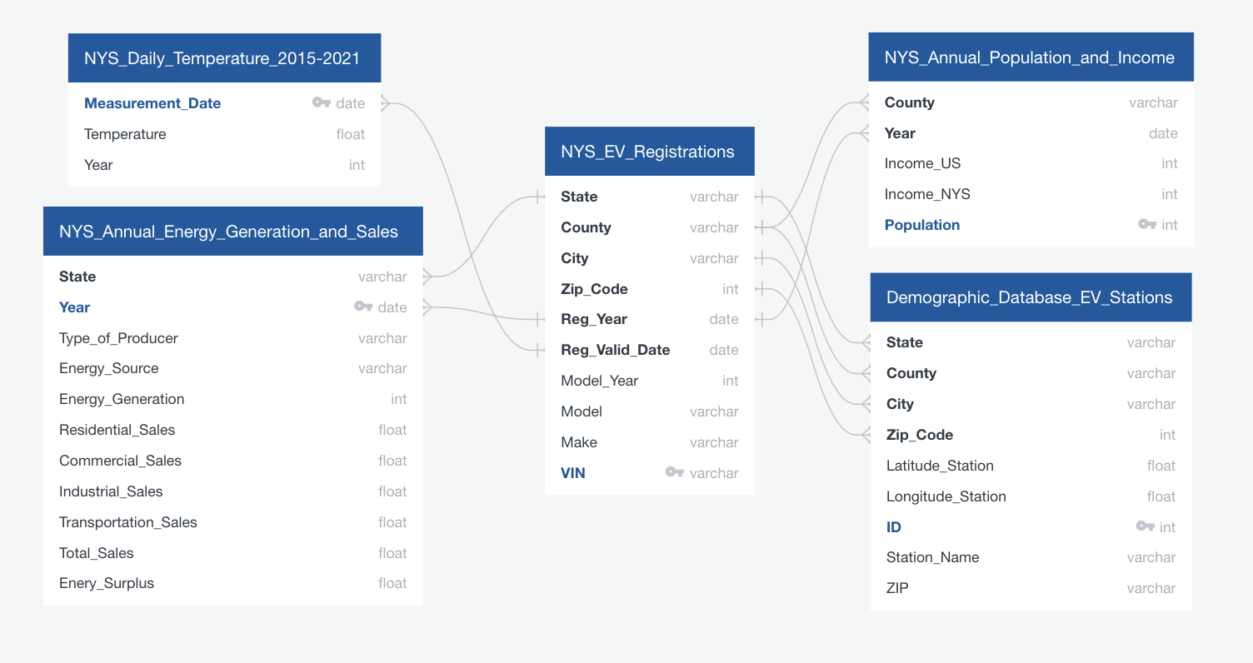
Sources of Data
The database for this project is connecting to the AWS's relational database service (RDS) using SQLAlchemy and Python.
The structure of the database and the relations between database objects are designed using the QuickDBD tool.

Slide 7
Language and Tools
In order to get some of our trusted information, we installed 2 additional Python libraries:
Meteostat
The Meteostat Python library provides simple access to open weather and climate data using Pandas. Historical observations and statistics are obtained from Meteostat's bulk data interface and consist of data provided by different public interfaces, most of which are governmental. Among the data sources are national weather services like the National Oceanic and Atmospheric Administration (NOAA) and Germany's national meteorological service (DWD).
Uszipcode
Uszipcode Python is a famous module released on PyPi used to get the zipcode of a specific location. You can find the zip codes by using City, State, Coordinates, or zip code prefix. The module has already implemented a database containing all the zip codes and their city, state, and map borders.
Tableau

Slide 8

DATA EXPLORATION

Slide 9
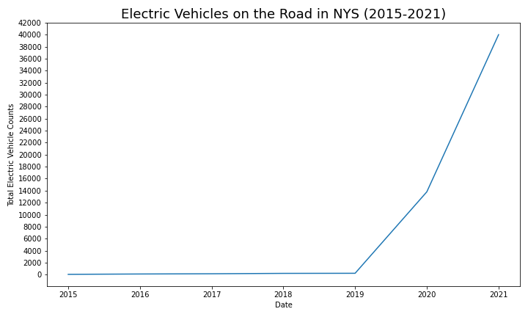
Number of EVs on the Road in NYS (2015-2021)
The EV registrations in NYS have been increasing exponentially since 2019.
Notes:
The total number of EVs in 2021 was 40356, which was over 791 times larger than the total number of EVs in 2015 (51).

Slide 10
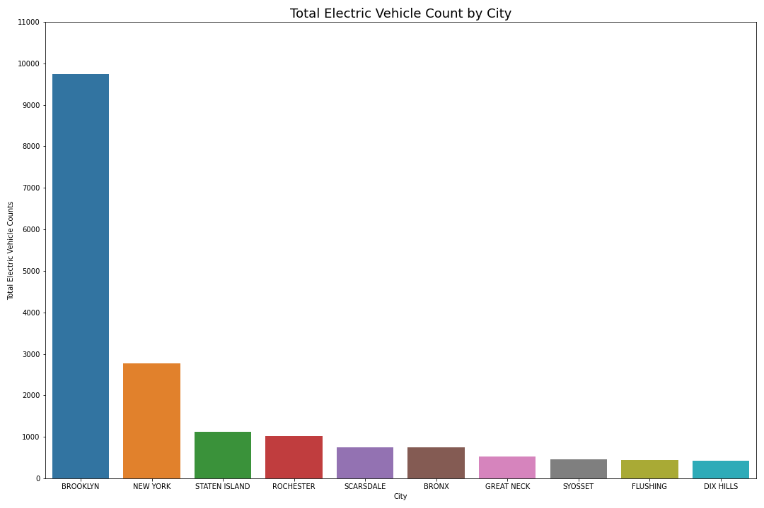
Total Number of EVs on the Road by City
(from 2015 to 2021)
Top 10 cities with the largest total number of EVs in NYS.
Notes:
As we can see, Brooklyn (9738), New York (2781), and Staten Island (1121) were the top 3 cities with the largest total number of EVs in NYS from 2015 to 2021.

Slide 11
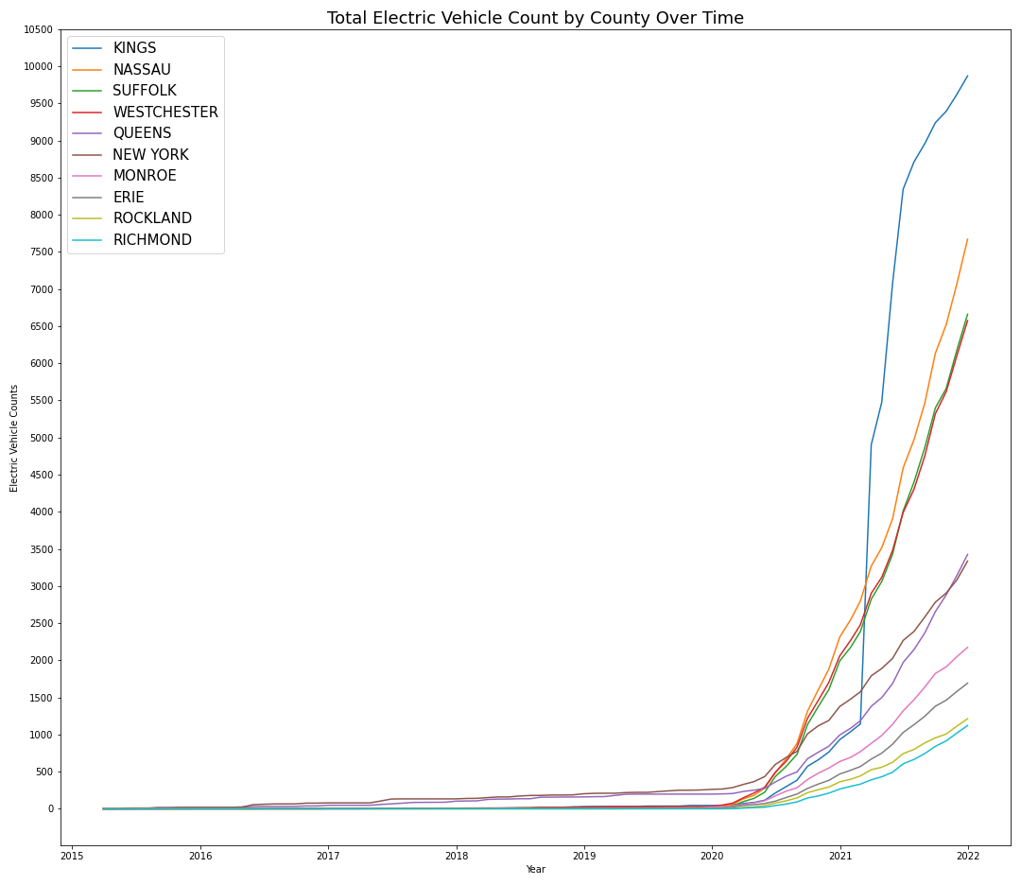
Number of EVs on the Road by County (2015-2022)
We explored the EV registrations from 2015 to 2021 in 10 top counties.
Kings County was growing much faster compared to other counties.

Slide 12
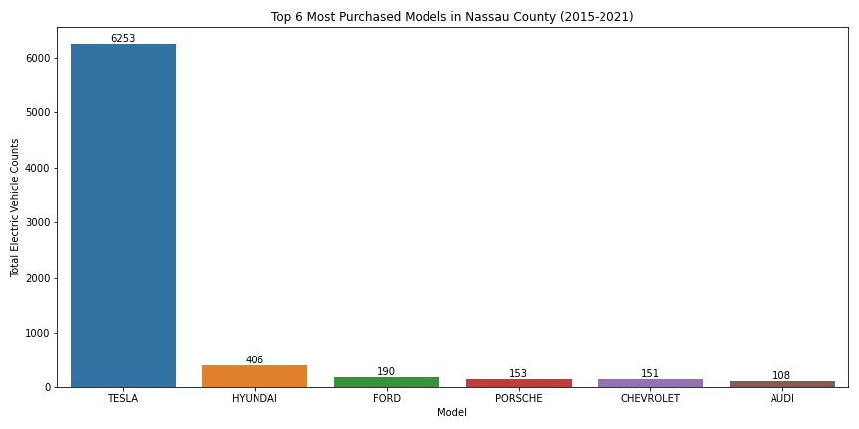
Popularity of EV Models by County
(from 2015 to 2021)
We selected the top 10 counties with the largest total number of EVs and figured out the top 6 most purchased EV models in each of these counties.
Overall, Tesla, Chevrolet, and Hyundai were the most purchased EVs in each of these counties.
Nassau County

Slide 13

DATA VISULIAZATION

Slide 14
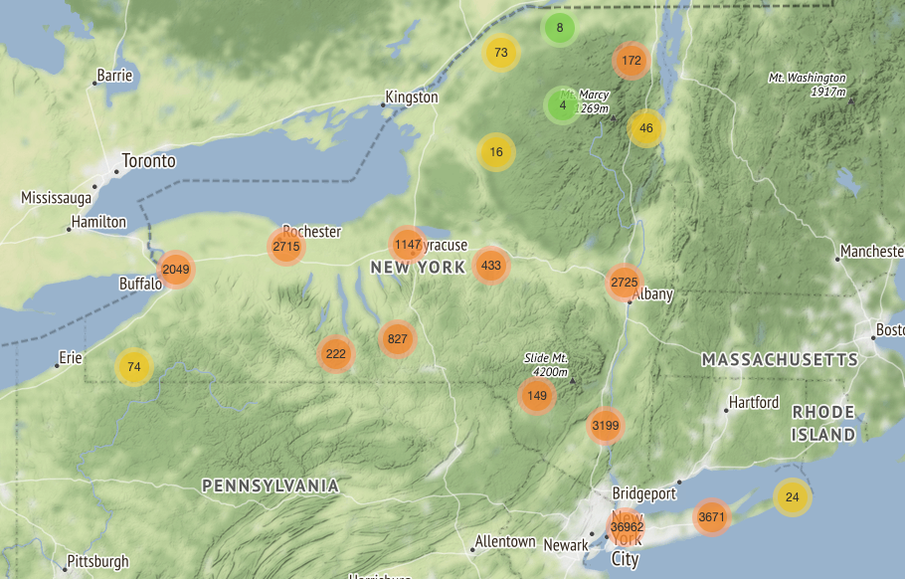
Folium Map
- NYS EV Registrations
14

Slide 15
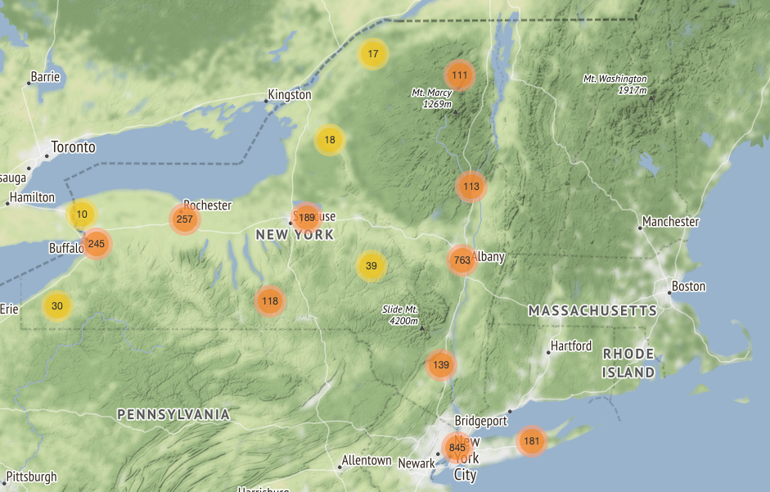
Folium Map
- NYS EV Charging Stations
15

Slide 16
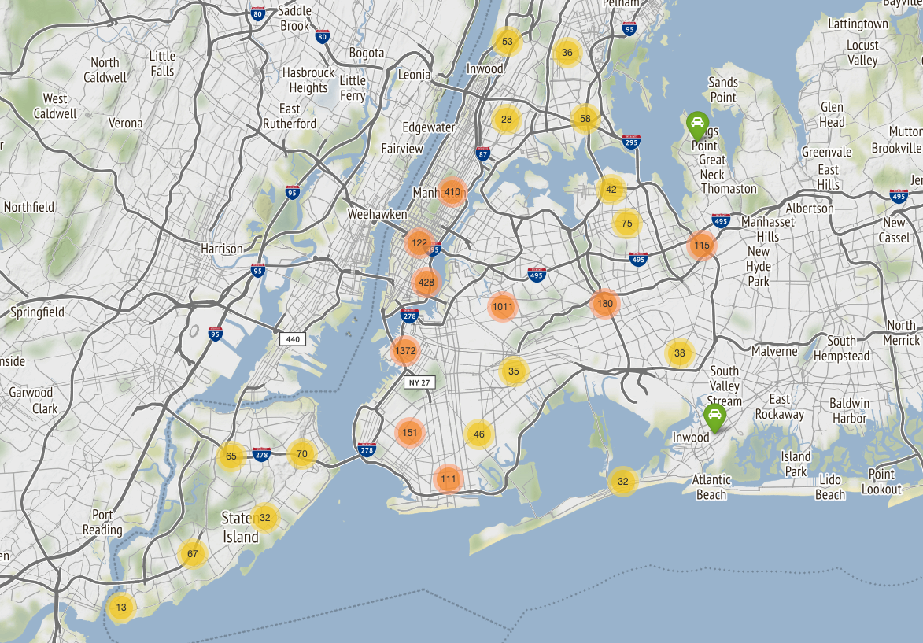
Folium Map
- New York City EV Registrations
16

Slide 17
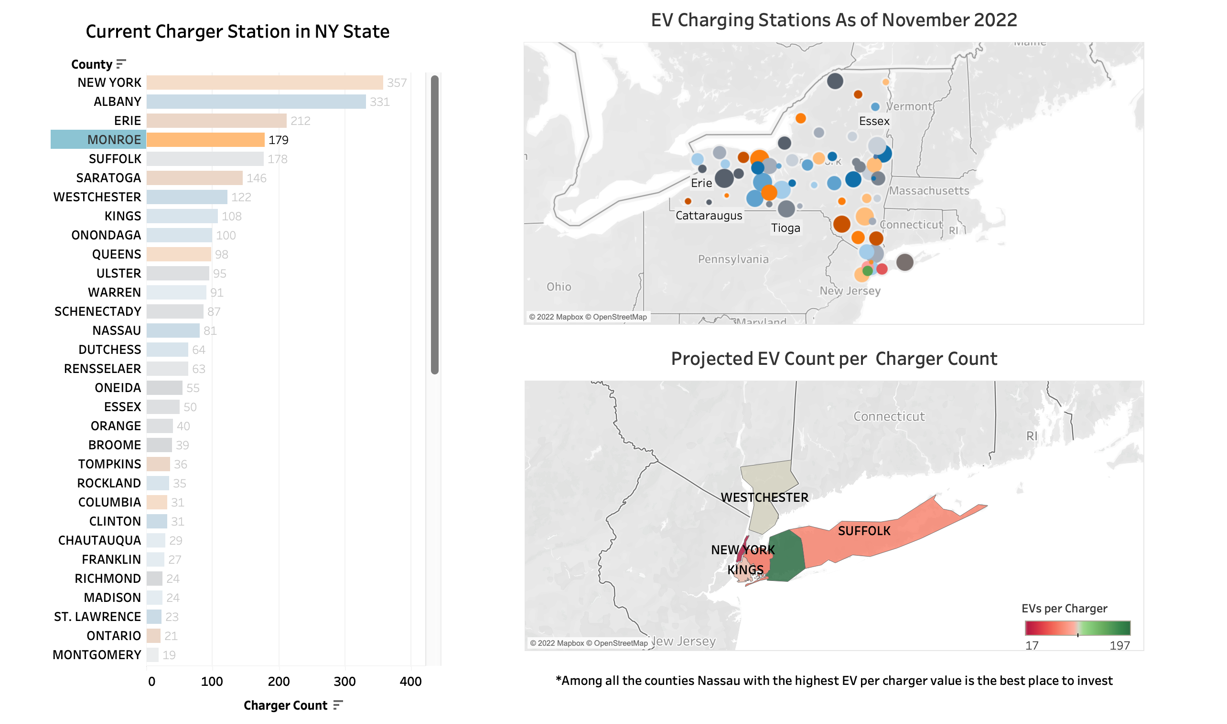
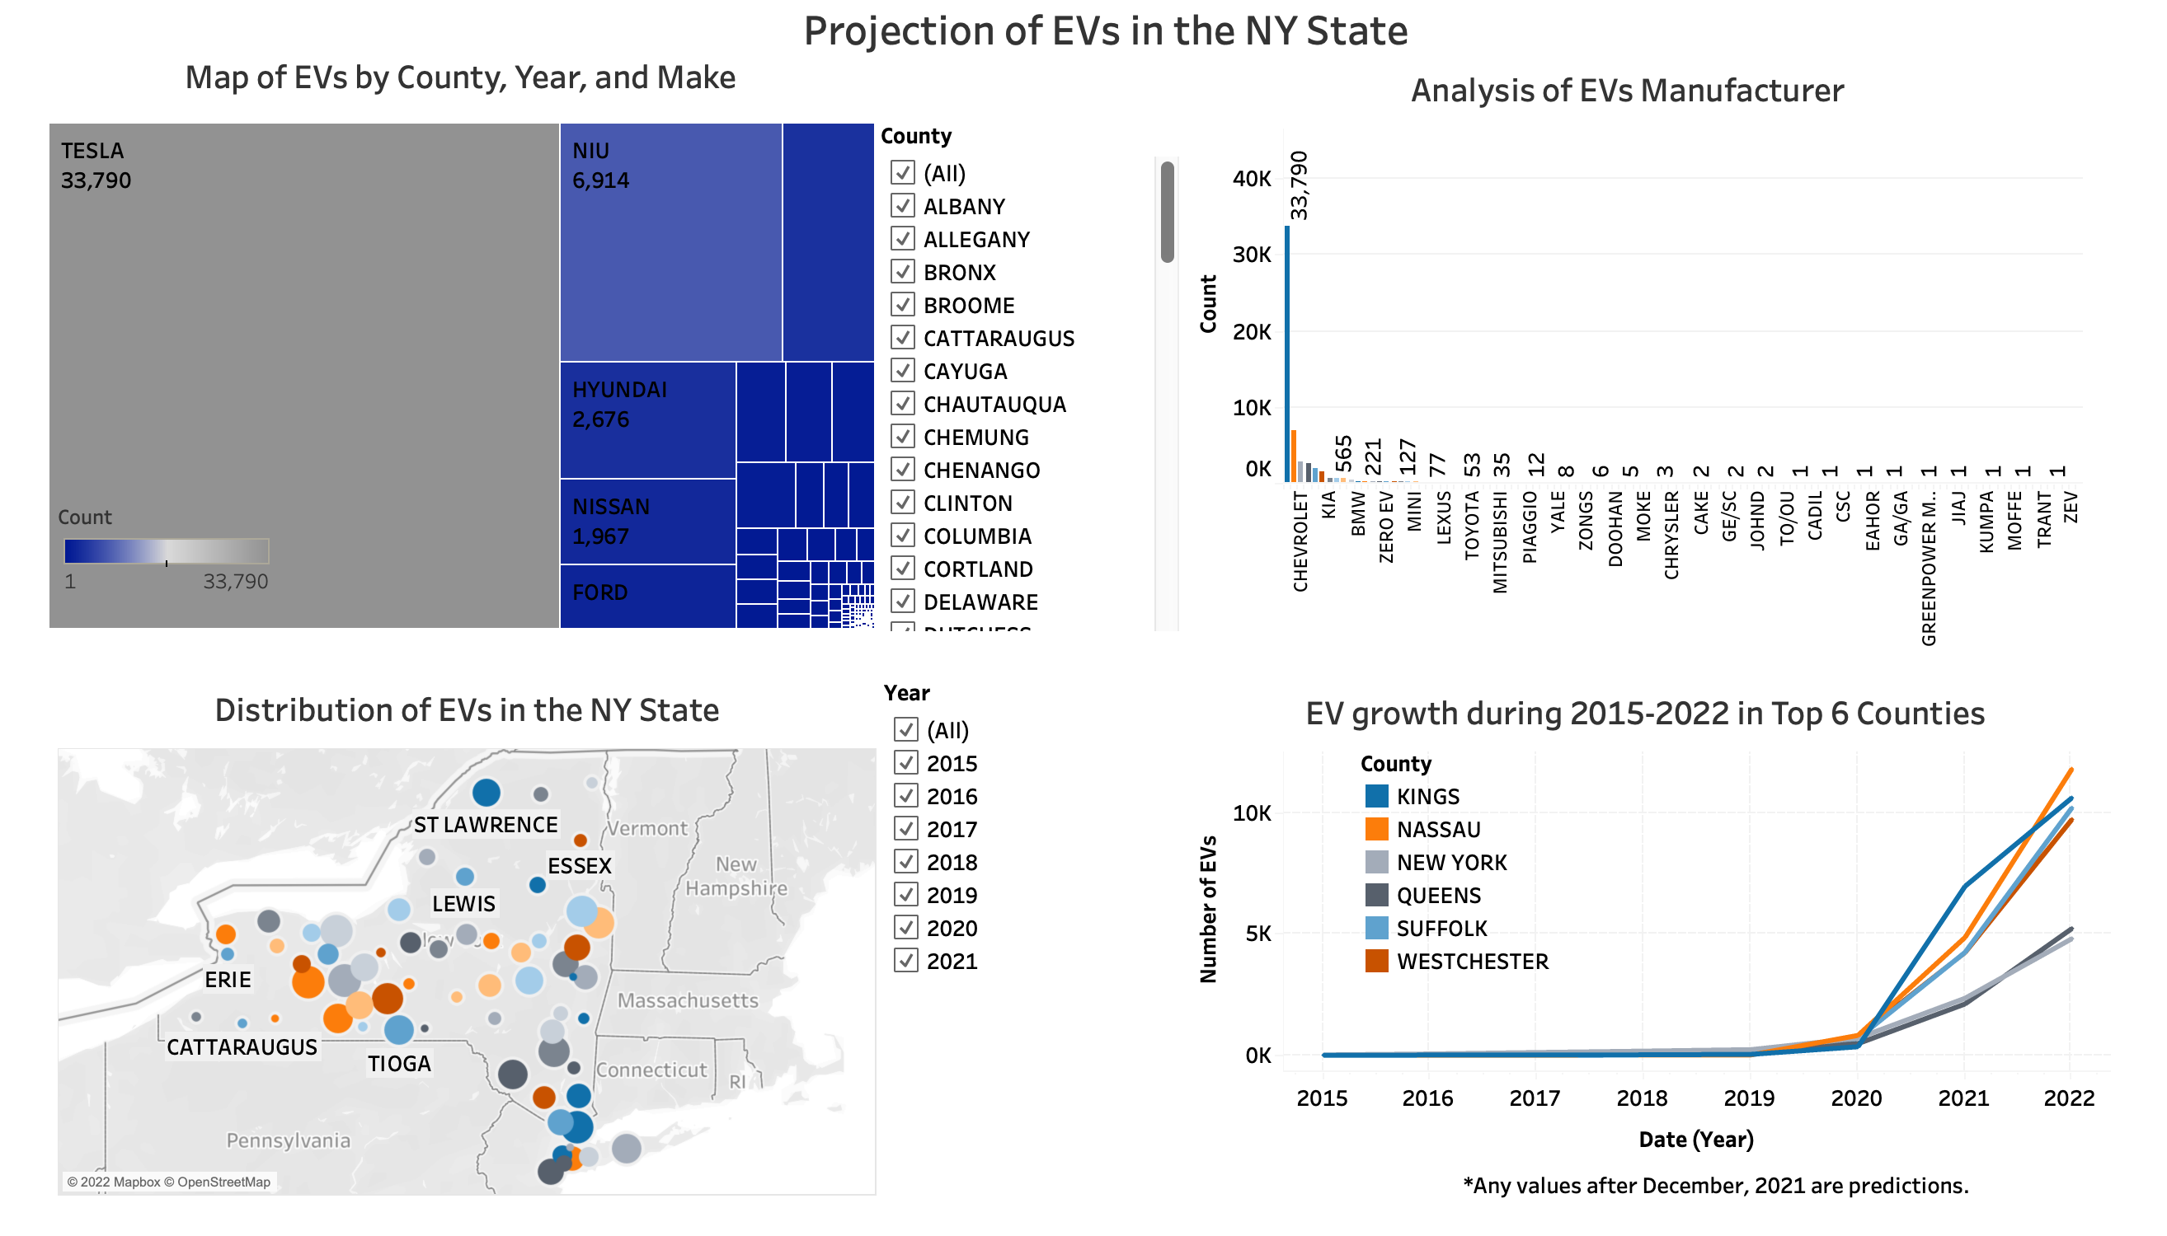
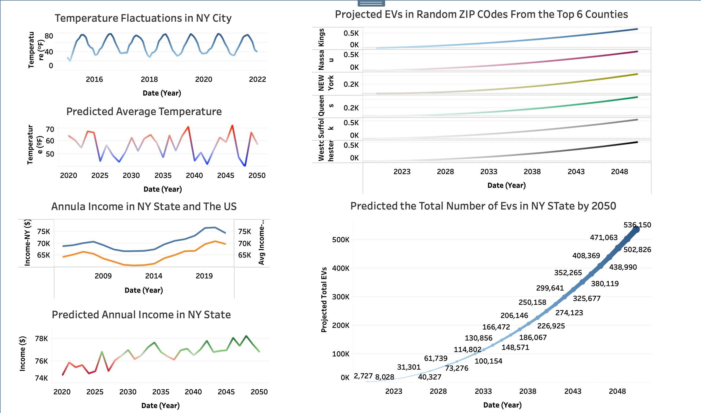
Tableau
- We also use Tableau to visualize our findings.
17

Slide 18

MACHINE LEARNING MODELS
PART 1
SARIMAX Model

Slide 19
SARIMAX Model
Predict the number of EVs in the top 6 counties with the most purchased EVs from 2015 to 2021 in NYS.
King County, Nassau County, Suffolk County, Westchester County, Queens County, and New York County
Approach:
Use King County as a sample
Perform Seasonality Check
Split Train and Test datasets, with a split ratio of 0.85/0.15.
Find the best parameters with Auto-ARIMA
Fit this model to other counties

Slide 20
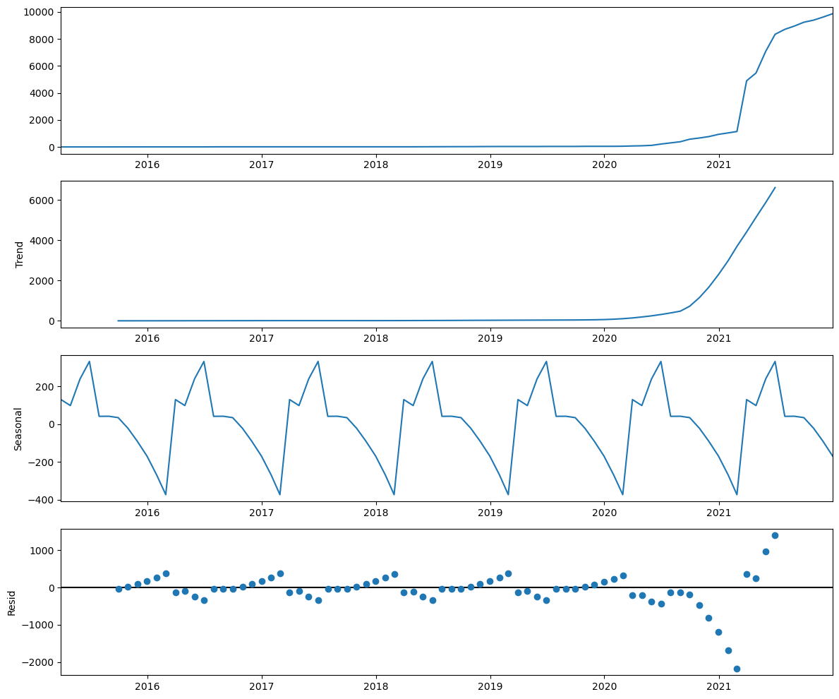
Seasonality Check
The number of EVs in King County had an upward trend and a seasonality pattern.
20

Slide 21
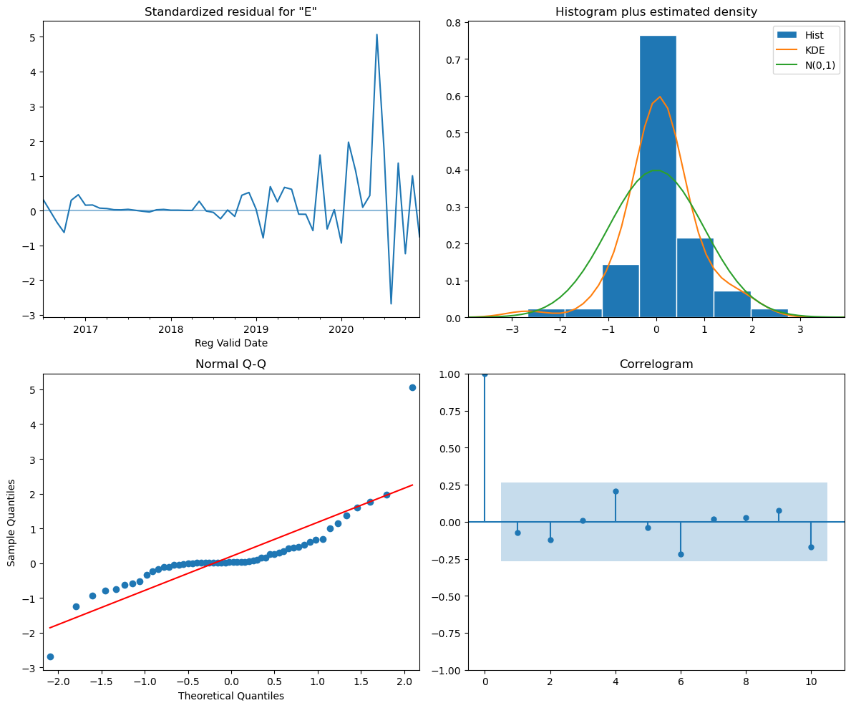
Residual Diagnostics
The residuals are close to being normally distributed.
We can accept it as the best model.
21

Slide 22
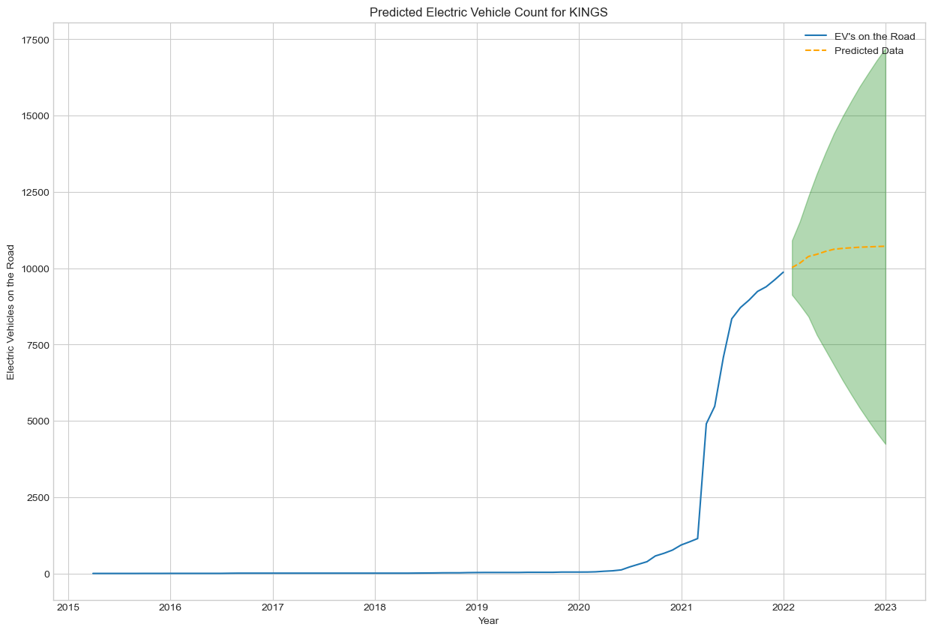
Future Prediction
- King County
The number of EVs are going to keep increasing.
It follows an exponential pattern in the upper confidence interval.

Slide 23
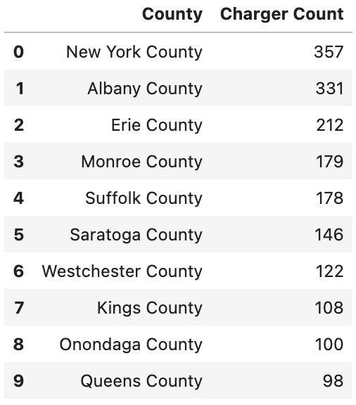
Future Predictions for Other Counties
The predicted number of EVs in other counties will also keep increasing exponentially by 2023.
Next, we will find the top 3 counties to invest for EV charging stations based on the predicted number of EVs in 2023.
The table on the right side is the current total number of EV charging stations per county (top 10) in NYS.

Slide 24
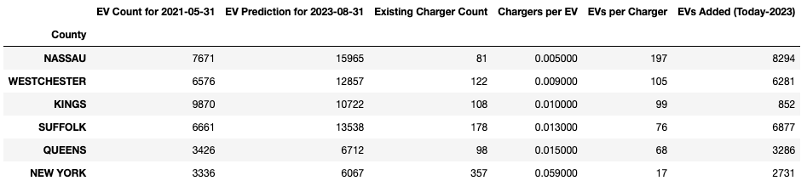
Demand for EV Charging Stations in 2023
The table below compares the numbers between existing charging stations and EVs 2021.
Top 3 counties good to invest for EV charging stations will be Kings County, Nassau County and Westchester County.
Notes:
Kings County has the largest predicted number of EVs in 2023, with 38135 new EVs added on the road. At that time, there will be 448 EVs per charging station, which makes it the best county to invest for EV charging stations.

Slide 25
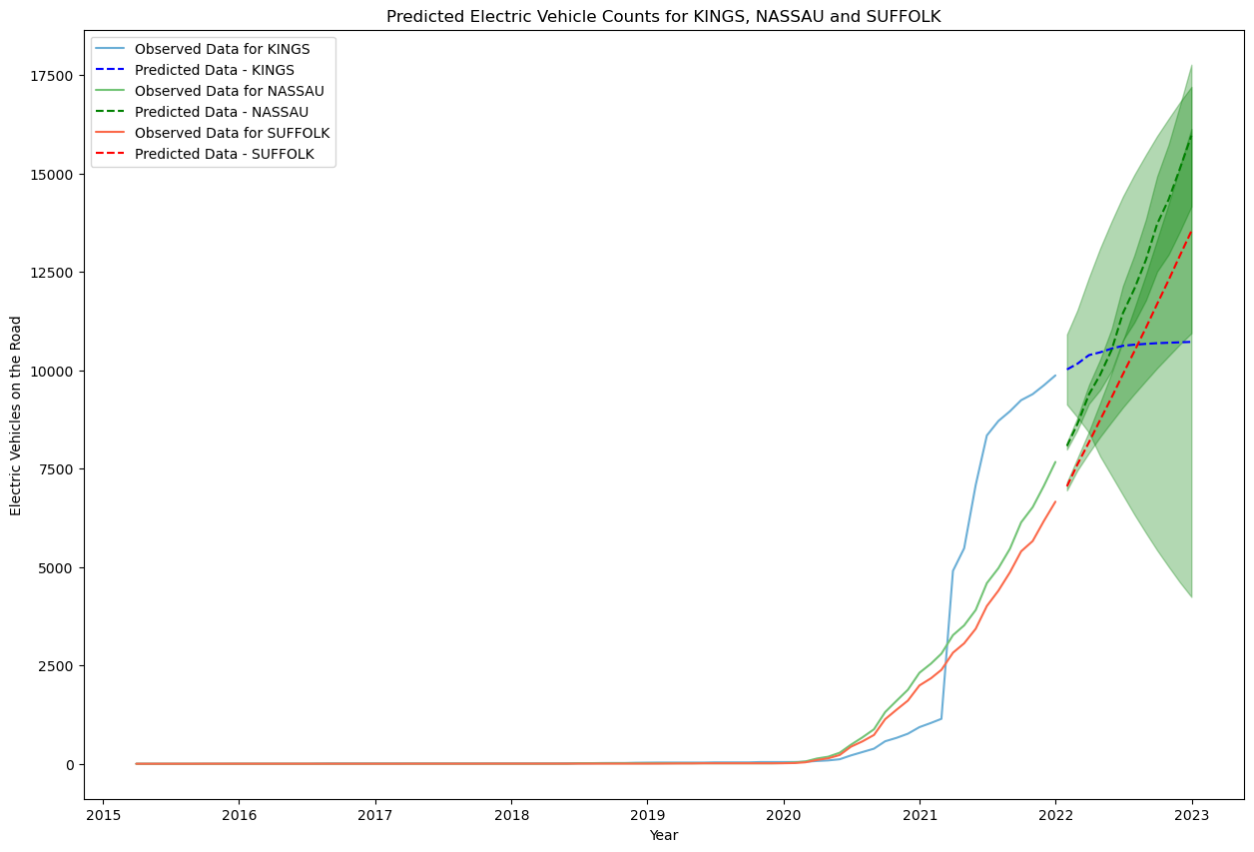

Slide 26
MACHINE LEARNING MODELS
PART 2
Linear Regression Model

Slide 27
Linear Regression Model
Predict the total EV adoption in NYS from 2020 to 2050, and explore the factors are associated with EV adoption.
Features: ZIP code, temperature, and income data of NYS
Approach:
Perform one-hot encoding for the categorical variable, ZIP Code.
Hypothesize that the EV adoption follow a linear pattern.
Fit the data into the linear model, then evaluate the model by the mean squared error of the prediction v.s. the true label.
Modify the model by removing outlier ZIP codes and generating future temperature and income data from 2020 to 2050.
Make future matrix and predict EV adoption using based on it.

Slide 28
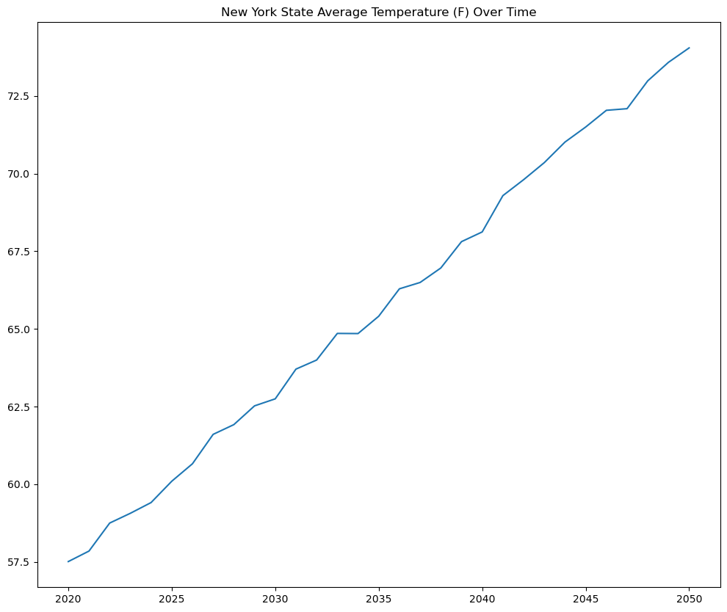
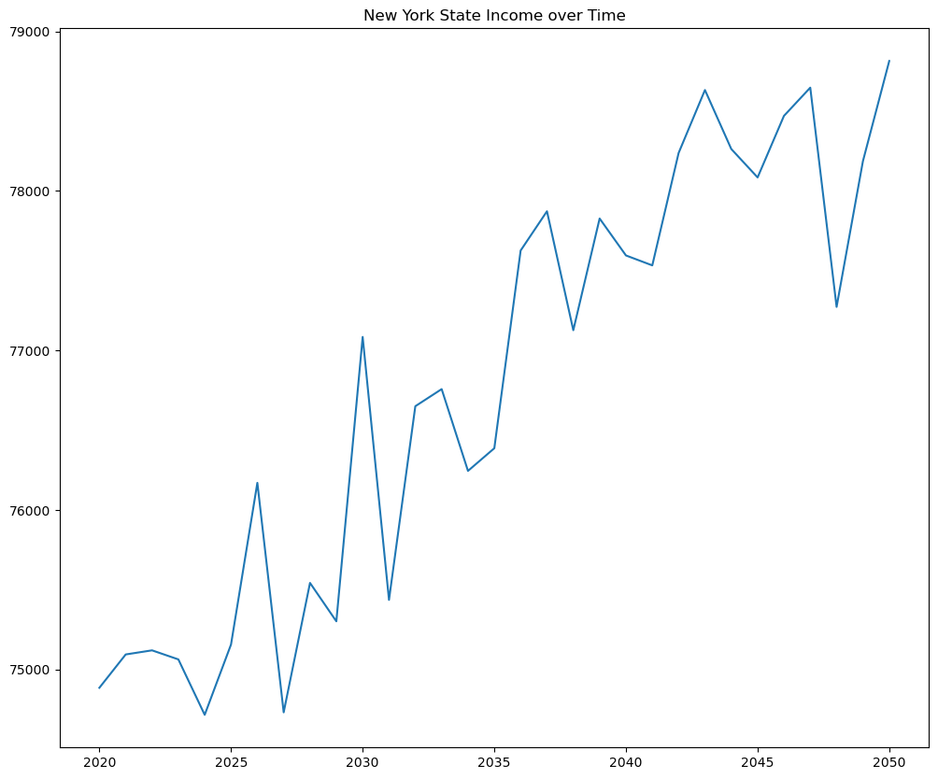
NYS Temperature and Income Data Generation
Hypothesize that NYS temperature and income data follow a linear pattern.
Generate the future data from 2020 to 2050 based on a linear model.
Add Gaussian noise based on the standard deviation of the known data.

Slide 29
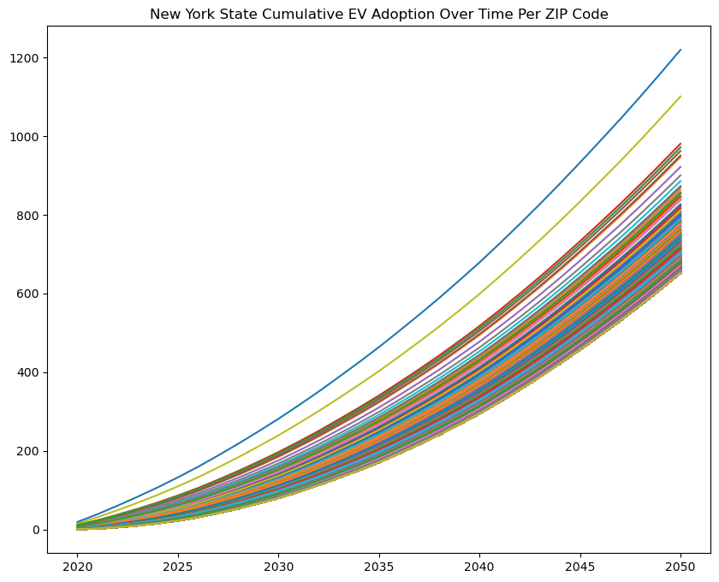
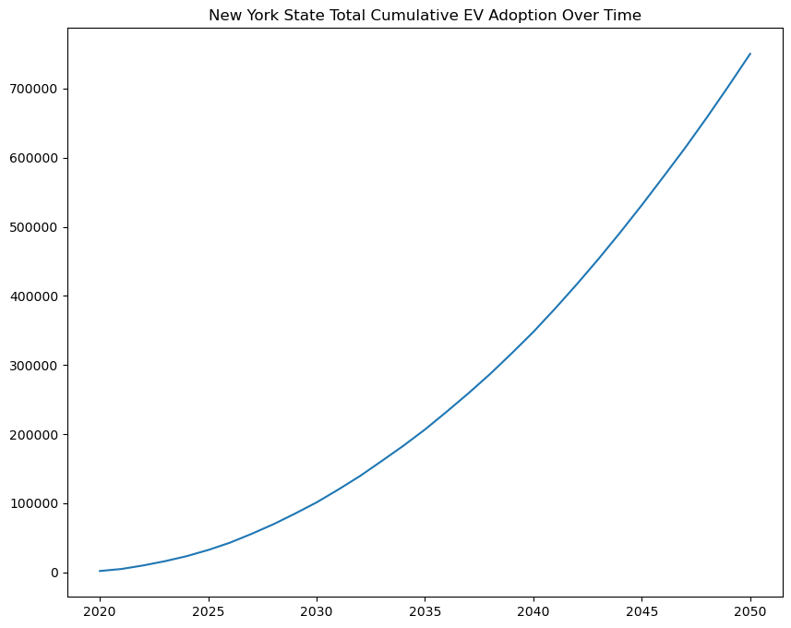
Predict Using the Future Matrix
Create the future matrix based on the future temperature and income data, then predict the EV adoption from 2020 to 2050 using this matrix.
Our model predicts that NYS will have 750,328 EVs by 2050.
29
Notes:
In total, our model predicts that NY state will have over 750328 EVs by 2050.

Slide 30
Electrical Infrastructure Sustainability for EVs
Next, we want to figure out whether the current electrical infrastructural capacity of NYS can handle the increased number of EVs by 2050.
Data sources for electrical Infrastructure :
Breakdown of annual electric energy generation
in each state from 1990 to 2020
Breakdown of annual electric energy consumption
in each state from 2000 to 2018
22% of NYS energy generation comes from renewable sources.
The annual average energy surplus in NYS is 8.44 x 10⁸ MWh
Energy Surplus = Energy Generation – Energy Consumption

Slide 31
Combine EV Adoption with Electrical Infrastructure
Next, we calculated the average energy surplus per ZIP code by computing the proportion of current NYS population in each ZIP code.
Assume:
Each EV owner drivers 15000 miles per year
Each EV consumes 6 MWh energy per year
Average electric consumption of EV is 2.5 mile/kWh
If only considering 22% of the energy surplus (1.3 x 10⁷ MWh), which is the energy from renewable sources, the surplus can support about 2.18 million EVs.
Notes:
Hypothesize that the EV adoption follow a linear pattern

Slide 32
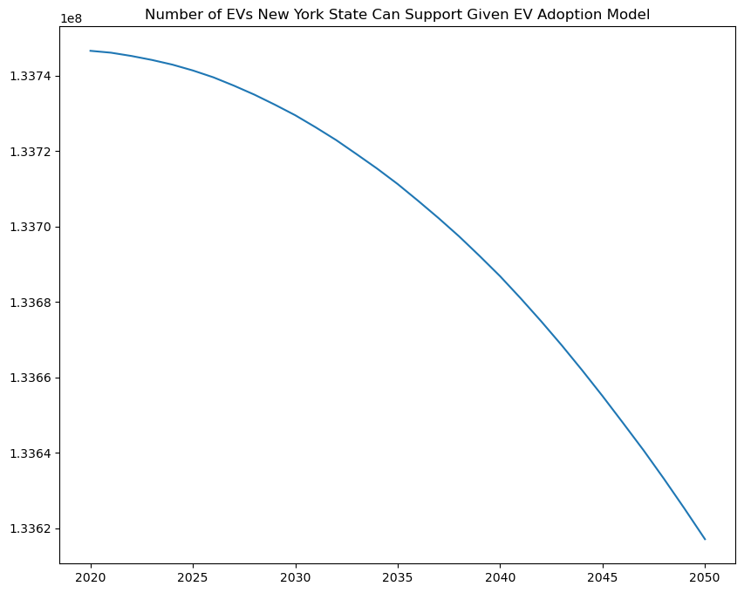
Number of EVs NYS Can Support by 2050
This means that even with our projected 750,328 EVs by 2050, NYS will still have enough renewable energy capacity to support all of them.
32

Slide 33
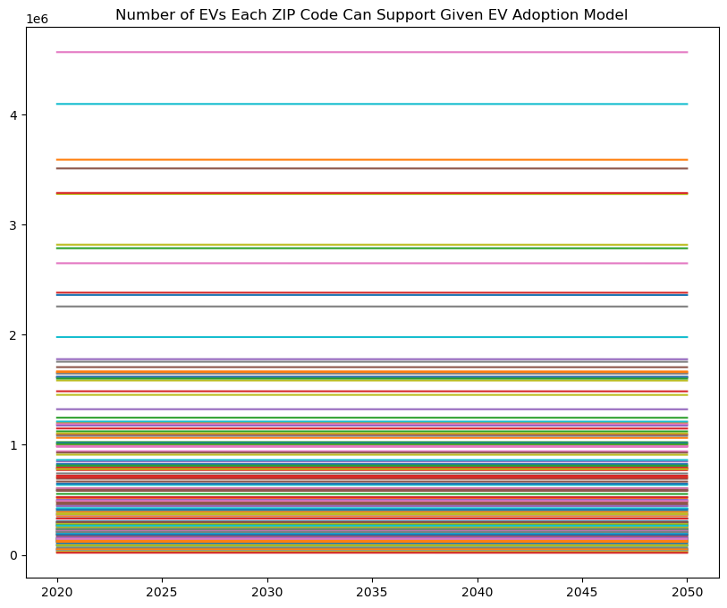
Number of EVs Each ZIP Code Can Support by 2050
There some ZIP codes in NYS that already do not have much surplus energy capacity.
They may struggle upon an influx of EVs adoption in the future.
33
Notes:
Let us take the average energy surplus across each ZIP code.

Slide 34

RESULTS AND RECOMMENDATOINS

Slide 35
Results and Conclusions
Brooklyn city has the largest total number (9738) of EVs in NYS by 2021.
Top 3 most purchased EV models in NYS are Tesla, Chevrolet, and Hyundai.
By 2023, Nassau County will have the largest predicted number of EVs (15965).
Top 3 best counties to invest for charging stations in NYS are Kings County, Nassau County, and Westchester County.
In total, NYS can support 30.8 million EVs through renewable energy surplus.
NYS will have over 746238 EVs by 2050. At that time, NYS will still have enough renewable energy capacity to support all of them.

Slide 36
Recommendations for Future Analysis
Due to time limitations, we had to limit our project to NYS only. There may be other states that are promising for future electric vehicle demand. In the future, we would like to model the EV sales for more states in U.S. to have a more comprehensive analysis.
Commuting patterns of residents in each county could be considered when analyzing the demand of EV charging stations. Most charging is done at home or at work. Finding counties that people tend to commute into for work, and accounting for this effect by adjusting the anticipated demand for chargers in these counties would result in more accurate recommendations.
To optimize our model for the EV Adoption in NYS from 2020 to 2050, besides temperature and income, we can also generate the future data for population and energy infrastructure in NYS.

Slide 37
Thank You
Questions?

